Slide 1
Can We Improve Flood Protection?
Nico Septianus

Slide 2
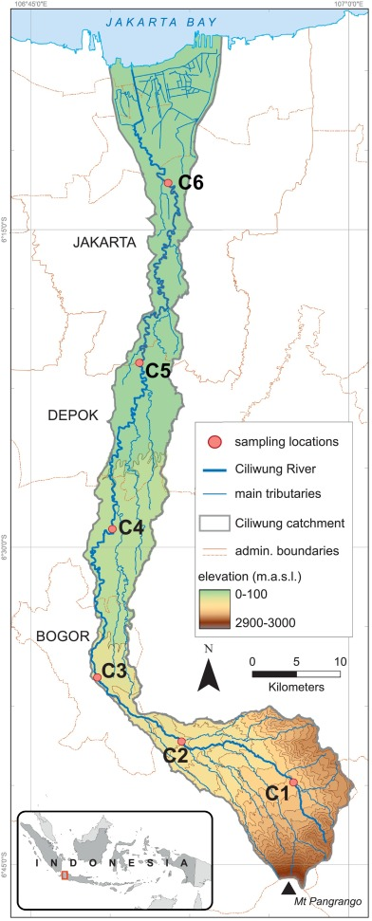
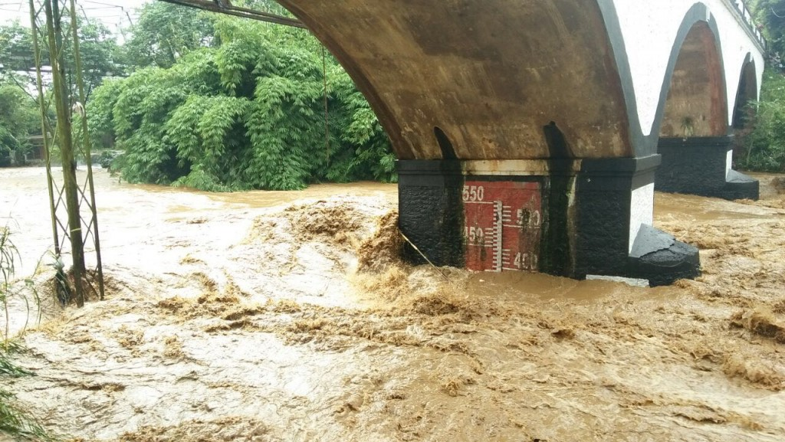
Introduction
Ciliwung River at early January 2020
Calculate FEV (Flood Excess Volume) = excess flood water
Mitigation Plan
Duvert. et al. (2019)

Slide 3
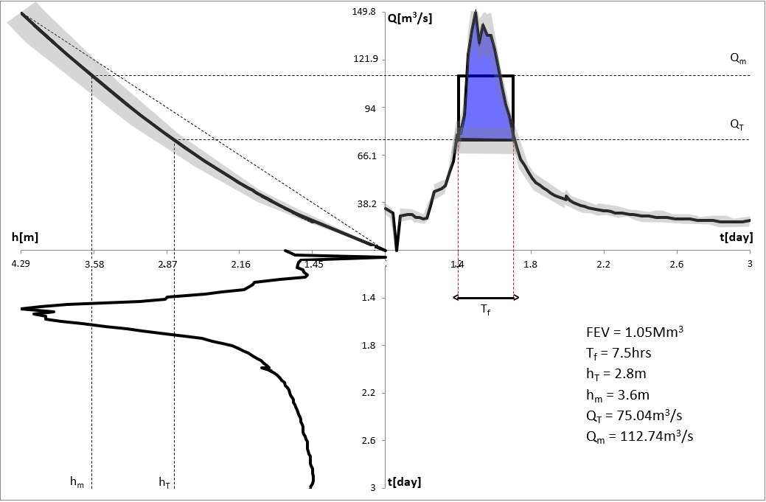

$${\text{Q}\text{ = 11.403 (}\text{H}\text{ + 0.2)}}^{1.715}$$

Slide 4
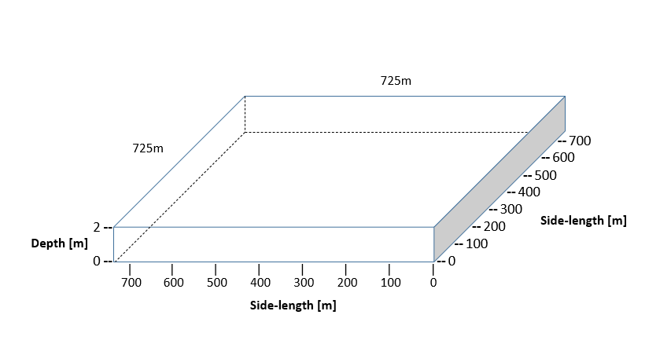
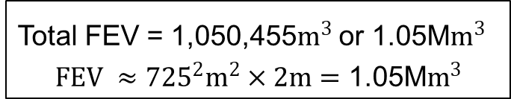
Flood mitigation
Total FEV = 1,050,455$m^{3}$ or 1.05M$m^{3}$
$$FEV ≈{725}^{2}m^{2}×2m=\text{1.05}\text{M}m^{3}$$

Slide 5
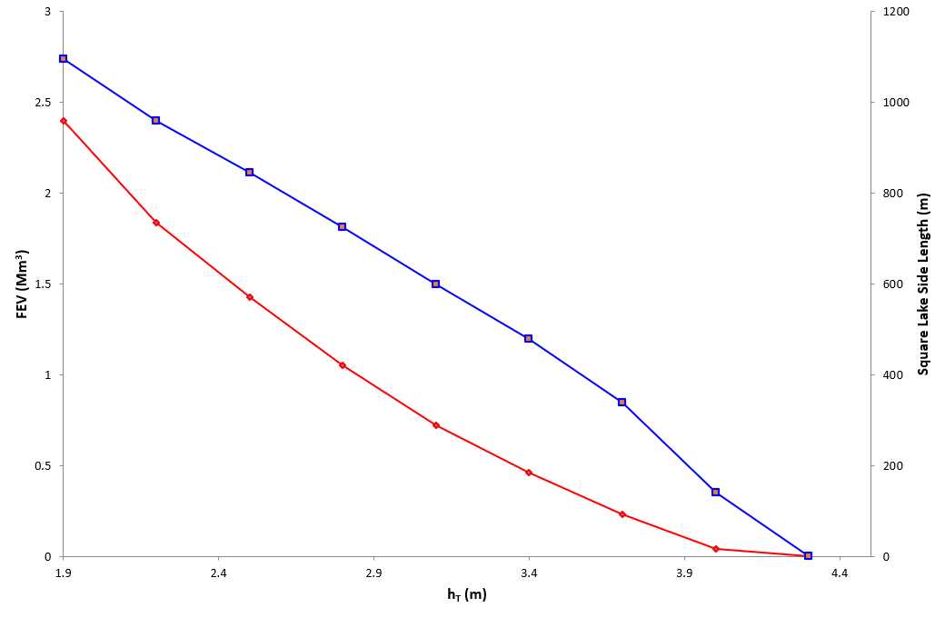


Relationships between choice of $h_{T }$and corresponding FEV (red) and side length of a 2m-deep surface (blue)
$h_{T }$= 2.8m

Slide 6
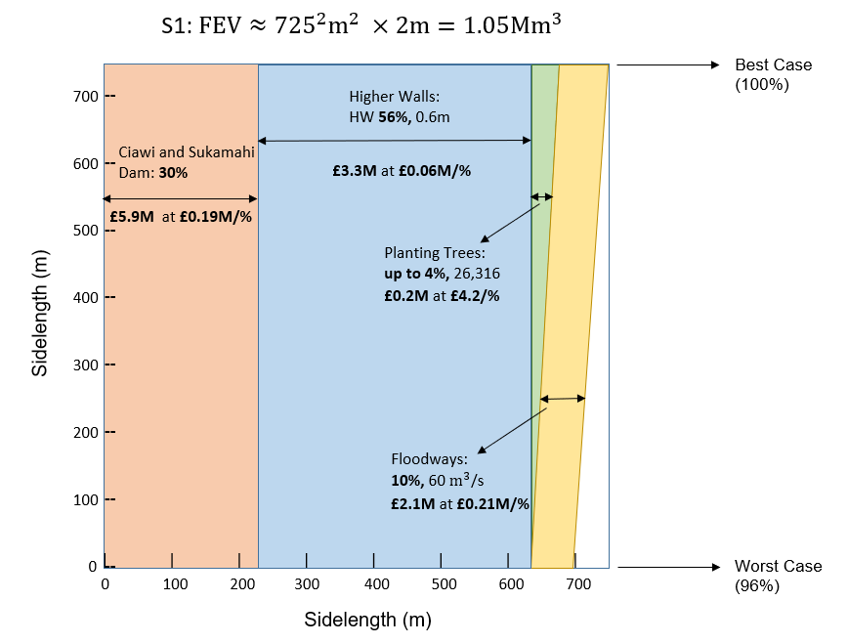
Mitigation Plan
0.6m

Slide 7
Future Plan
Get and implement the correct error rate for the hydrograph.
Add more possible mitigation alternative and the cost of it.

